Slide 1
Using Mobile Technology to Test the Immediate Effect of Cognitive Defusion in a Clinical Sample
Kristy L. Dalrymple, Ph.D.
Brandon A. Gaudiano, Ph.D.
Lia Rosenstein, B.A.
Emily Walsh, B.A.
Mark Zimmerman, M.D.
Association for Contextual Behavioral Science
Minneapolis, June 2014

Slide 2
Acknowledgements
Grant Funding:
NIMH K23MH085730 (PI: Dalrymple)
Additional Research Assistants/students:
Jennifer Martinez
Elizabeth Tepe
Trevor Lewis
Kathryn Nowlan
Special thanks to Dr. Akihiko Masuda!

Slide 3
Defusion
Reducing attachment to thoughts by altering the context
i.e., experiencing thoughts as thoughts
“I am having the thought that I’m worthless”
Potential mediator of treatment effects
Believability of thoughts in depression/psychosis (Zettle et al., 2011; Bach et al., 2013; Gaudiano et al., 2010)

Slide 4
Component Meta-Analysis (Levin et al., 2012)

Slide 5
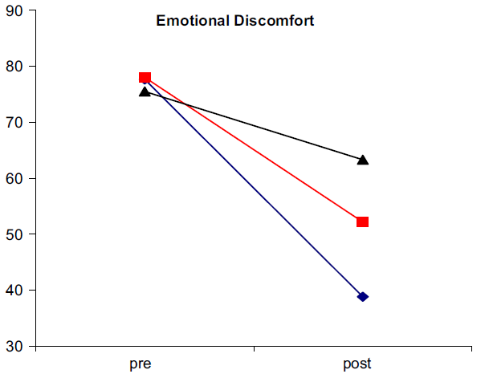
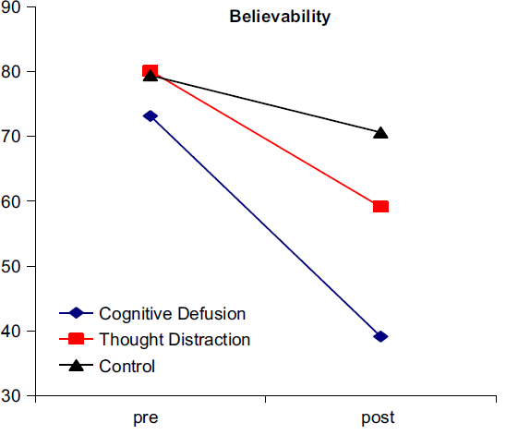
Defusion and Depression Masuda, Twohig, et al. (2010)

Slide 6
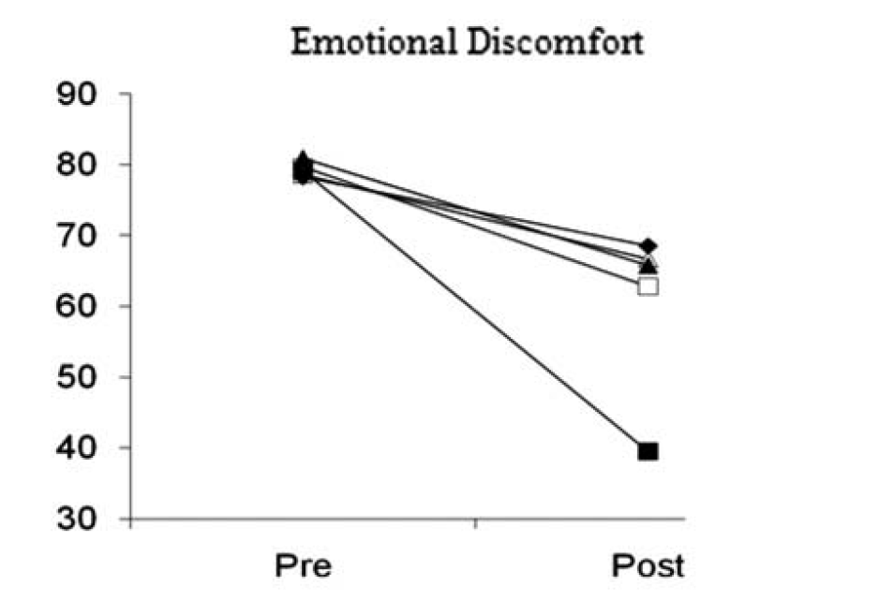
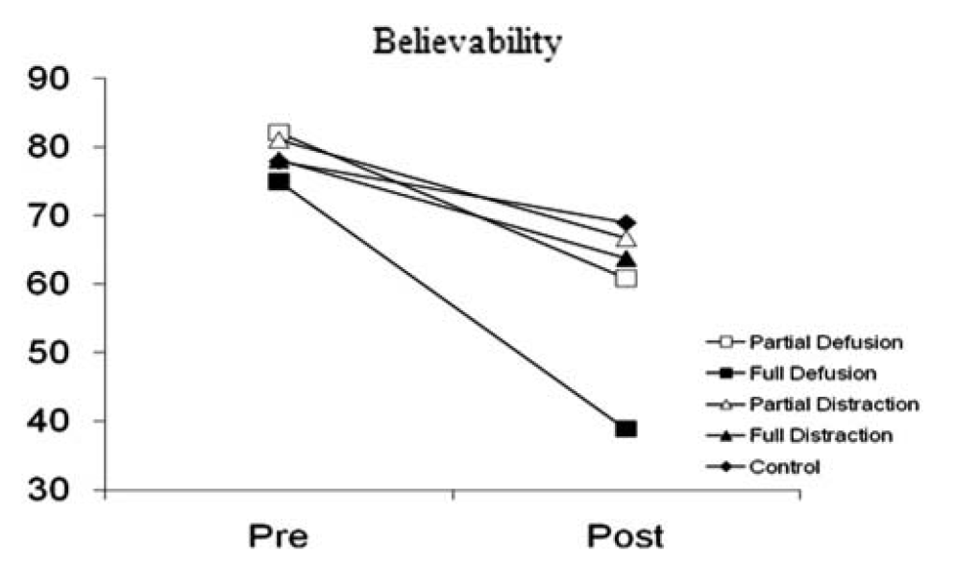
Defusion and Depression Masuda, Feinstein, et al. (2010)

Slide 7
Current Study Rationale
Preliminary evidence for defusion as a mediator/effective component
No studies testing defusion in a clinical sample diagnosed with depression
Technology-based defusion tasks being used clinically, but have never been tested
Enhance treatment effects, increase generalization

Slide 8
Current Study Aims
Recruit sample of individuals with clinical depression
Isolate and test immediate effect of defusion on self-relevant negative thoughts
Test incremental effect of technology-enhanced defusion task

Slide 9
Hypotheses
Defusion tasks → lower thought distress & believability vs. thought distraction
Technology enhanced defusion (ECD) → lower distress & believability vs. standard defusion (SCD) → lower distress & believability vs. thought distraction

Slide 10
Participants
74 adults with current depressive disorder diagnosis
Exclusions:
Bipolar disorder
Psychosis
Active suicidal ideation
Currently receiving ACT

Slide 11
Recruitment
Referred by treatment provider based on diagnosis
Or
Responded to social media ad; then confirmed by brief diagnostic interview (SCID mood & psychosis modules)
Compensated $10 for participation

Slide 12
Assessment Schedule
Measure | Baseline | Post-Task1 | Post-Task2
Demographics Form | X
CUDOS | X
AAQ-II | X
PANAS | X |  | X
Thought Distress & Believability | X | X | X
Usefulness Scale |  |  | X

Slide 13
General Procedures
Initial Thought Selection
Repeated, Distressing, Believable (at least moderate severity)
Randomly Assigned to:
Standard Cognitive Defusion
Next-day Phone Call
Follow-up Distress & Believability
Enhanced Cognitive Defusion
Thought Distraction
Did you practice?

Slide 14
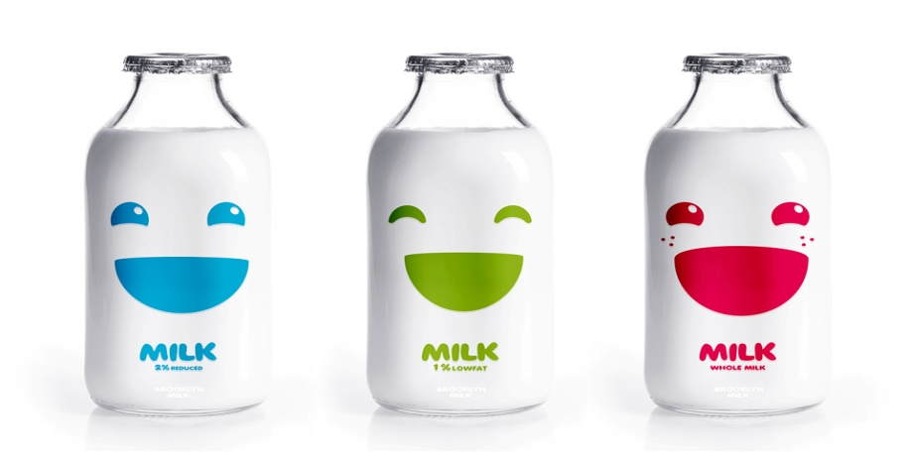
Standard Cognitive Defusion
Rationale and training with “milk”
Task 1: repeat self-relevant word for 20 sec.
Task 2: same as Task 1

Slide 15
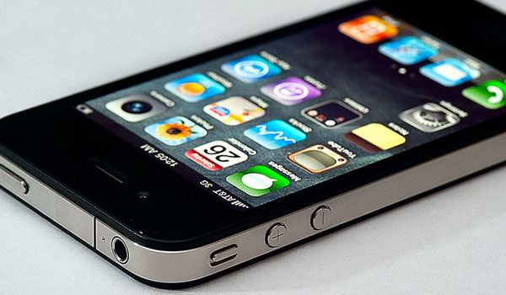
Enhanced Cognitive Defusion
Rationale and training with “milk”
Task 1: repeat self-relevant word for 20 sec.
Record with Voice Changer app
Task 2: playback recording in “helium”

Slide 16
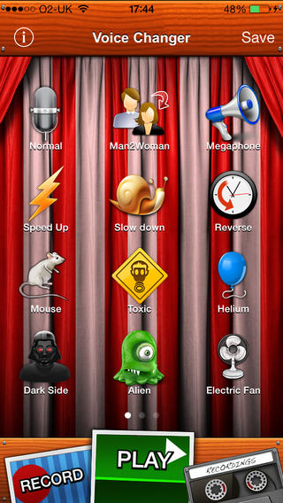

Slide 17
Thought Distraction
Rationale and training with “milk”
Task 1: distract from self-relevant word for 20 sec.
Task 2: distract again

Slide 18
Sample
75% female
82% Caucasian
M Age = 42
41% never married, 34% married/cohabitating
41% HS/GED as highest degree
47% employed, 37% unemployed/disability
Ns: SCD = 23; ECD = 24; TD = 27
Most common thoughts: failure, worthless

Slide 19
Primary Analyses
Hypothesis 1: Overall, defusion will result in lower thought distress and believability ratings compared to thought distraction
ANCOVAs for Task 1 and 2 ratings, controlling for pre task ratings

Slide 20
Thought Distress
*p =0.03

Slide 21
Believability
p = 0.07
*p = 0.05

Slide 22
Next Day Follow-up
N=63
57% reported practicing strategy on own
No difference between groups

Slide 23
Follow-up Ratings
*p = 0.05

Slide 24
Primary Analyses
Hypothesis 2: Enhanced cognitive defusion will produce an increased effect compared with standard defusion after Task 2
ANCOVAs separately for TD vs. SCD and TD vs. ECD

Slide 25
Thought Distress Task 2
*p = 0.03

Slide 26
Thought Believability Task 2

Slide 27
Thought Distress: SCD vs. ECD
d = 0.43
d = 0.75
Between Cohen’s d = 0.31

Slide 28
Believability: SCD vs. ECD
d = 0.42
d = 0.70
Between Cohen’s d = 0.35

Slide 29
Acceptability

Slide 30
Discussion
Hypothesis 1 supported
Effect of defusion combined > thought distraction by Task 2
Partial support for Hypothesis 2
For Task 2 distress, ECD > TD but SCD not > TD
Consistent with other studies on non-clinical populations
Acceptable strategies

Slide 31
Implications
Converging evidence that defusion is an important part of model
Technology-enhanced defusion at least as effective & easy to use as standard defusion
Introduces an additional contextual manipulation that may enhance defusion effect
Mobility & low-cost may facilitate greater practice, generalization

Slide 32
Limitations
Small sample size
Low power for direct SCD-ECD comparisons
Missing next-day follow-up data
Clinician diagnoses versus brief diagnostic interview

Slide 33
Future Directions
Test in larger sample
Cognitive restructuring (CR) as comparison rather than thought distraction
Yovel et al. 2014: CR vs. CD after mood induction
Similarly effective in improving mood
Operated through different appraisal vs. acceptance mechanisms
Take-home component: practice on own, come back for follow-up

